Slide 1

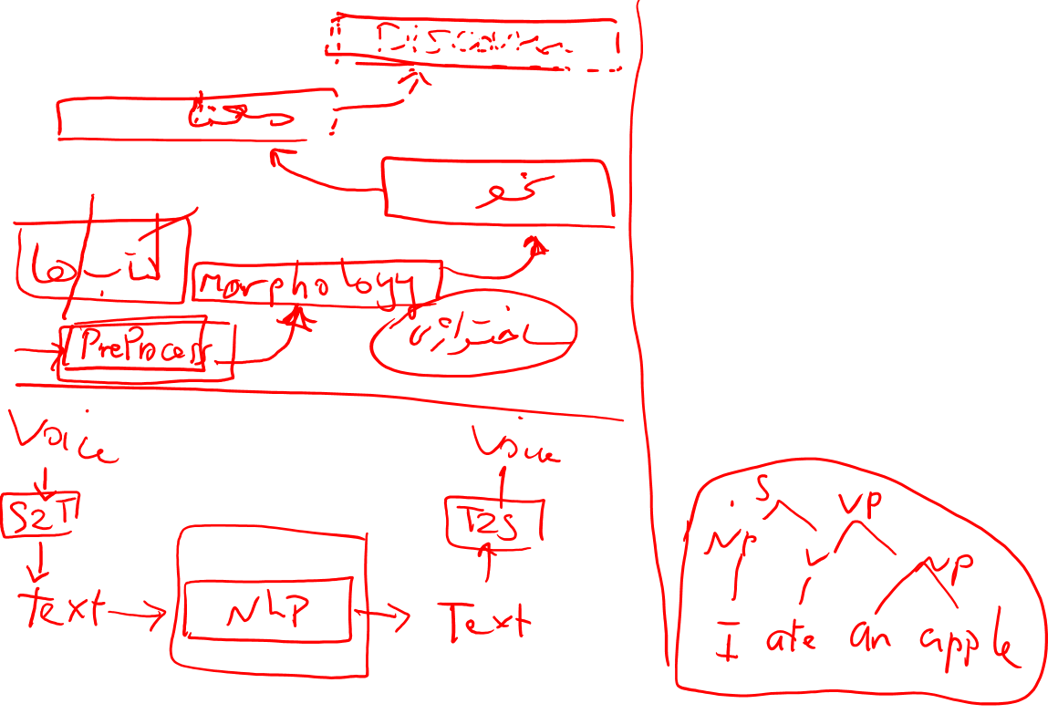
Basic Text Processing
Regular Expressions

Slide 2

Regular Expressions, Text Normalization, Edit Distance
ELIZA: You are X=>“What makes you think I am X?”
Chatbot
Regular expression
Text normalization:converting it to a more convenient, standard form
Tokenization: “New York” , “rock ’n’ roll”, “I’m”, :) #nlproc ,
Lemmatization: sing, sang, sung
Stemming: goes: go+es
sentence segmentation

Slide 3
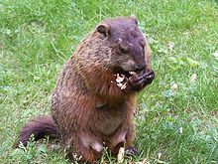

Regular expressions
A formal language for specifying text strings
How can we search for any of these?
woodchuck
woodchucks
Woodchuck
Woodchucks

Slide 4

Regular Expressions: Disjunctions
Letters inside square brackets []
Ranges [A-Z]
Pattern | Matches
[wW]oodchuck | Woodchuck, woodchuck
[1234567890] | Any digit
Pattern | Matches
[A-Z] | An upper case letter | Drenched Blossoms
[a-z] | A lower case letter | my beans were impatient
[0-9] | A single digit | Chapter 1: Down the Rabbit Hole

Slide 5

Regular Expressions: Negation in Disjunction
Negations [^Ss]
Carat means negation only when first in []
Pattern | Matches
[^A-Z] | Not an upper case letter | Oyfn pripetchik
[^Ss] | Neither ‘S’ nor ‘s’ | I have no exquisite reason”
[^e^] | Neither e nor ^ | Look here
a^b | The pattern a carat b | Look up a^b now

Slide 6

Regular Expressions: More Disjunction
Woodchucks is another name for groundhog!
The pipe | for disjunction
Pattern | Matches
groundhog|woodchuck
yours|mine | yours mine
a|b|c | = [abc]
[gG]roundhog|[Ww]oodchuck

Slide 7
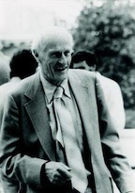

Regular Expressions: ? * + .
Pattern | Matches
colou?r | Optional previous char | color colour
oo*h! | 0 or more of previous char | oh! ooh! oooh! ooooh!
o+h! | 1 or more of previous char | oh! ooh! oooh! ooooh!
baa+ |  | baa baaa baaaa baaaaa
beg.n |  | begin begun begun beg3n
Stephen C Kleene
Kleene *, Kleene +

Slide 8

Regular Expressions: Anchors ^ $ \b \B
Pattern | Matches
^[A-Z] | Palo Alto
^[^A-Za-z] | 1 “Hello”
\.$ | The end.
.$ | The end? The end!
\b : word boundary, word mean sequence of digits, underscores, or letters; | \bthe\n
\B: non word boundary

Slide 9

Example
Find me all instances of the word “the” in a text.
the
Misses capitalized examples
[tT]he
Incorrectly returns other or theology
[^a-zA-Z][tT]he[^a-zA-Z]

Slide 10
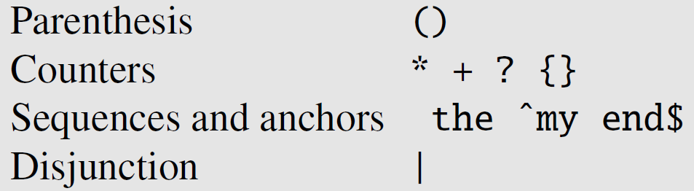

Precedence
guppy and guppies: /guppy|ies/ or /gupp(y|ies)/
/the*/ matches theeeee but not thethe.

Slide 11

Errors
The process we just went through was based on fixing two kinds of errors
Matching strings that we should not have matched (there, then, other)
False positives (Type I)
Not matching things that we should have matched (The)
False negatives (Type II)

Slide 12

Errors cont.
In NLP we are always dealing with these kinds of errors.
Reducing the error rate for an application often involves two antagonistic efforts:
Increasing accuracy or precision (minimizing false positives)
Increasing coverage or recall (minimizing false negatives).

Slide 13
Summary
Regular expressions play a surprisingly large role
Sophisticated sequences of regular expressions are often the first model for any text processing text
For many hard tasks, we use machine learning classifiers
But regular expressions are used as features in the classifiers
Can be very useful in capturing generalizations

Slide 14
Basic Text Processing
Regular Expressions

Slide 15
Basic Text Processing
Word tokenization

Slide 16
How many words?
I do uh main- mainly business data processing
Fragments, filled pauses
Seuss’s cat in the hat is different from other cats!
Lemma: same stem, part of speech, rough word sense
cat and cats = same lemma
Wordform: the full inflected surface form
cat and cats = different wordforms

Slide 17
How many words?
they lay back on the San Francisco grass and looked at the stars and their
Type: an element of the vocabulary.
Token: an instance of that type in running text.
How many?
15 tokens (or 14)
13 types (or 12) (or 11?)

Slide 18
How many words?
N = number of tokens
V = vocabulary = set of types
|V| is the size of the vocabulary
 | Tokens = N | Types = |V|
Switchboard phone conversations | 2.4 million | 20 thousand
Shakespeare | 884,000 | 31 thousand
Google N-grams | 1 trillion | 13 million
Brown corpus | 1 million | 38 thousand
COCA(Corpus of Contemporary American English ) | 440 million | 2 million

Slide 19
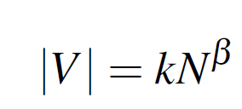
Herdan’s Law (Herdan, 1960) or Heaps’ Law (Heaps, 1978
beta ranges from .67 to .75.
Church and Gale (1990): |V| > O(N^{½})

Slide 20
Text Normalization
1. Segmenting/tokenizing words from running text
2. Normalizing word formats
3. Segmenting sentences in running text

Slide 21
Simple Tokenization in UNIX
(Inspired by Ken Church’s UNIX for Poets.)
Given a text file, output the word tokens and their frequencies
tr -sc ’A-Za-z’ ’\n’ < shakes.txt
| sort
| uniq –c
1945 A
72 AARON
19 ABBESS
5 ABBOT
... ...
Change all non-alpha to newlines
-sc: squeeze all sequence of
Complement of ‘A-Za-z’ to ‘\n’
Sort in alphabetical order
Merge and count each type
25 Aaron
6 Abate
1 Abates
5 Abbess
6 Abbey
3 Abbot
.... …

Slide 22
The first step: tokenizing
tr -sc ’A-Za-z’ ’\n’ < shakes.txt | head
THE
SONNETS
by
William
Shakespeare
From
fairest
creatures
We
...

Slide 23
The second step: sorting
tr -sc ’A-Za-z’ ’\n’ < shakes.txt | sort | head
A
A
A
A
A
A
A
A
A
...

Slide 24
More counting
Merging upper and lower case
tr ‘A-Z’ ‘a-z’ < shakes.txt | tr –sc ‘A-Za-z’ ‘\n’ | sort | uniq –c
Sorting the counts
tr ‘A-Z’ ‘a-z’ < shakes.txt | tr –sc ‘A-Za-z’ ‘\n’ | sort | uniq –c | sort –n –r
23243 the
22225 i
18618 and
16339 to
15687 of
12780 a
12163 you
10839 my
10005 in
8954 d
What happened here?

Slide 25
Issues in Tokenization
Finland’s capital → Finland Finlands Finland’s ?
what’re, I’m, isn’t → What are, I am, is not
Hewlett-Packard → Hewlett Packard ?
state-of-the-art → state of the art ?
Lowercase → lower-case lowercase lower case ?
San Francisco → one token or two?
m.p.h., PhD. → ??
میرود → می رود می.رود
کتابخانه → کتاب خانه – کتاب.خانه
خوانده ام → خوانده.ام
خوانده است → خوانده است - خوانده.است

Slide 26
Tokenization: language issues
French
L'ensemble → one token or two?
L ? L’ ? Le ?
Want l’ensemble to match with un ensemble
German noun compounds are not segmented
Lebensversicherungsgesellschaftsangestellter
‘life insurance company employee’
German information retrieval needs compound splitter

Slide 27
Tokenization: language issues
Chinese and Japanese no spaces between words:
莎拉波娃现在居住在美国东南部的佛罗里达。
莎拉波娃 现在 居住 在 美国 东南部 的 佛罗里达
Sharapova now lives in US southeastern Florida
Further complicated in Japanese, with multiple alphabets intermingled
Dates/amounts in multiple formats
フォーチュン500社は情報不足のため時間あた$500K(約6,000万円)
Katakana
Hiragana
Kanji
Romaji
End-user can express query entirely in hiragana!

Slide 28
Word Tokenization in Chinese
Also called Word Segmentation
Chinese words are composed of characters, called Hanzi
Characters are generally 1 syllable and 1 morpheme.
Average word is 2.4 characters long.
Standard baseline segmentation algorithm:
Maximum Matching (also called Greedy)
Require a dictionary

Slide 29
Word Tokenization in Persian
90% of errors in Persian is because of Space
Half Space (Zero weight non joiner-ZWNJ)
Relatively high morphological language
Arabic, Turkish, ….
Compound words : “می روم” "نگاه میکند"
میدیدمشان
منمشتعلعشقعلیمچهکنم

Slide 30
Maximum Matching Word Segmentation Algorithm
Given a wordlist of Chinese, and a string.
Start a pointer at the beginning of the string
Find the longest word in dictionary that matches the string starting at pointer
Move the pointer over the word in string
Go to 2

Slide 31
Max-match segmentation illustration
Thecatinthehat
Thetabledownthere
Doesn’t generally work in English!
But works astonishingly well in Chinese, Chinese has much shorter words than English
莎拉波娃现在居住在美国东南部的佛罗里达。
莎拉波娃 现在 居住 在 美国 东南部 的 佛罗里达
Modern probabilistic segmentation algorithms even better
the cat in the hat
the table down there
theta bled own there

Slide 32
Basic Text Processing
Word tokenization

Slide 33
Basic Text Processing
Word Normalization and Stemming

Slide 34
Normalization
Need to “normalize” terms
Information Retrieval: indexed text & query terms must have same form.
We want to match U.S.A. and USA
We implicitly define equivalence classes of terms
e.g., deleting periods in a term
Alternative: asymmetric expansion:
Enter: window Search: window, windows
Enter: windows Search: Windows, windows, window
Enter: Windows Search: Windows
Potentially more powerful, but less efficient

Slide 35
Case folding
Applications like IR: reduce all letters to lower case
Since users tend to use lower case
Possible exception: upper case in mid-sentence?
e.g., General Motors
Fed vs. fed
SAIL vs. sail
For sentiment analysis, MT, Information extraction
Case is helpful (US versus us is important)

Slide 36
Lemmatization
The task of determining that two words have the same root despite of their surface
Reduce inflections or variant forms to base form
am, are, is → be
car, cars, car's, cars' → car
the boy's cars are different colors → the boy car be different color
Lemmatization: have to find correct dictionary headword form
Machine translation
Spanish quiero (‘I want’), quieres (‘you want’) same lemma as querer ‘want’

Slide 37
Morphology
Morphemes:
The small meaningful units that make up words
Stems: The core meaning-bearing units
Affixes: Bits and pieces that adhere to stems
Often with grammatical functions
Cars : car + s(plural)
Goes : go + s(singular third)

Slide 38
Stemming
Reduce terms to their stems in information retrieval
Stemming is crude chopping of affixes
language dependent
e.g., automate(s), automatic, automation all reduced to automat.
for example compressed
and compression are both
accepted as equivalent to
compress.
for exampl compress and
compress ar both accept
as equival to compress

Slide 39
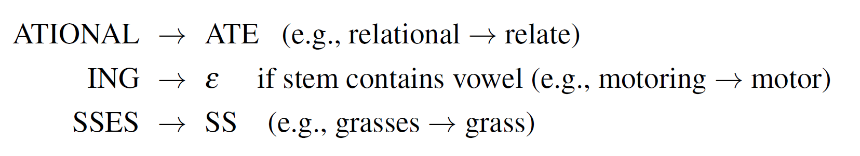
Porter Stemmer
Rewrite rules as cascades

Slide 40
Porter’s algorithm The most common English stemmer
Step 1a
sses → ss caresses → caress
ies → i ponies → poni
ss → ss caress → caress
s → ø cats → cat
Step 1b
(*v*)ing → ø walking → walk
sing → sing
(*v*)ed → ø plastered → plaster
…
Step 2 (for long stems)
ational→ ate relational→ relate
izer→ ize digitizer → digitize
ator→ ate operator → operate
…
Step 3 (for longer stems)
al → ø revival → reviv
able → ø adjustable → adjust
ate → ø activate → activ
…

Slide 41
Viewing morphology in a corpus Why only strip –ing if there is a vowel?
(*v*)ing → ø walking → walk
sing → sing

Slide 42
Viewing morphology in a corpus Why only strip –ing if there is a vowel?
(*v*)ing → ø walking → walk
sing → sing
tr -sc 'A-Za-z' '\n' < shakes.txt | grep ’ing$' | sort | uniq -c | sort –nr
tr -sc 'A-Za-z' '\n' < shakes.txt | grep '[aeiou].*ing$' | sort | uniq -c | sort –nr
1312 King
548 being
541 nothing
388 king
375 bring
358 thing
307 ring
152 something
145 coming
130 morning
548 being
541 nothing
152 something
145 coming
130 morning
122 having
120 living
117 loving
116 Being
102 going

Slide 43
Dealing with complex morphology is sometimes necessary
Some languages requires complex morpheme segmentation
Turkish
Uygarlastiramadiklarimizdanmissinizcasina
`(behaving) as if you are among those whom we could not civilize’
Uygar `civilized’ + las `become’
+ tir `cause’ + ama `not able’
+ dik `past’ + lar ‘plural’
+ imiz ‘p1pl’ + dan ‘abl’
+ mis ‘past’ + siniz ‘2pl’ + casina ‘as if’
Persian
میدیدمشان -

Slide 44
Basic Text Processing
Word Normalization and Stemming

Slide 45
Basic Text Processing
Sentence Segmentation and Decision Trees

Slide 46
Sentence Segmentation
!, ? are relatively unambiguous
Period “.” is quite ambiguous
Sentence boundary
Abbreviations like Inc. or Dr.
Numbers like .02% or 4.3
Build a binary classifier
Looks at a “.”
Decides EndOfSentence/NotEndOfSentence
Classifiers: hand-written rules, regular expressions, or machine-learning

Slide 47
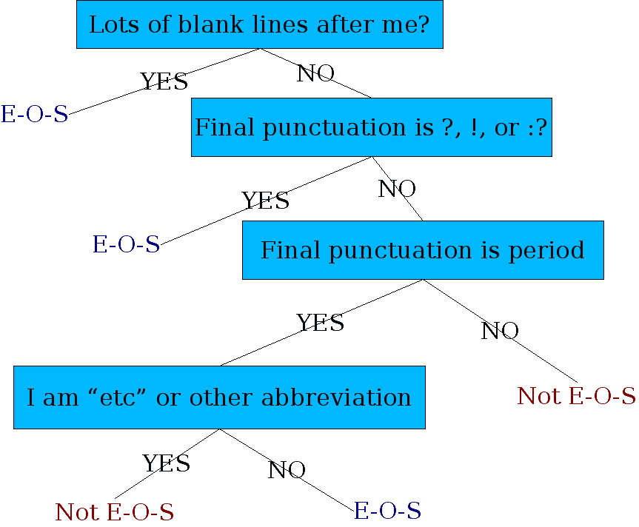
Determining if a word is end-of-sentence: a Decision Tree

Slide 48
More sophisticated decision tree features
Case of word with “.”: Upper, Lower, Cap, Number
Case of word after “.”: Upper, Lower, Cap, Number
Numeric features
Length of word with “.”
Probability(word with “.” occurs at end-of-s)
Probability(word after “.” occurs at beginning-of-s)

Slide 49
Implementing Decision Trees
A decision tree is just an if-then-else statement
The interesting research is choosing the features
Setting up the structure is often too hard to do by hand
Hand-building only possible for very simple features, domains
For numeric features, it’s too hard to pick each threshold
Instead, structure usually learned by machine learning from a training corpus

Slide 50
Decision Trees and other classifiers
We can think of the questions in a decision tree
As features that could be exploited by any kind of classifier
Logistic regression
SVM
Neural Nets
etc.

Slide 51
Basic Text Processing
Sentence Segmentation and Decision Trees

Slide 52
Tokenization
Byte Pair Encoding
(BPE)

Slide 53
Byte-Pair Encoding for Tokenization
Instead of defining tokens as words we can use our data to automatically tell us what size tokens should be
One word(spinach)
more words (New York Times)
subword: Less than one word a morpheme (-est) in word like smallest
Subword is used for unknown words
simplest algorithm for subword detection is BYTE-PAIR Encoding (BPE)

Slide 54
BPE
Byte-pair encoding is based on a method for text compression
The intuition of the algorithm is t iteratively merge frequent pairs of characters
begins with the set of symbols equal to the set of characters
Eac word is represented as a sequence of characters plus a special end-of-word symbol
At each step: count the number of symbol pairs
find the most frequent pair (‘A’, ‘B’)
replace it with the new merged symbol (‘AB’).
continue to count and merge until we’ve done k merges; k is a parameter of the algorithm

Slide 55
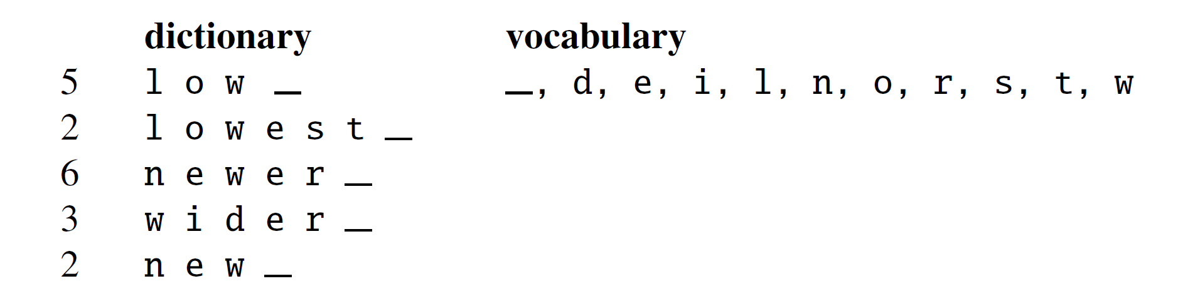
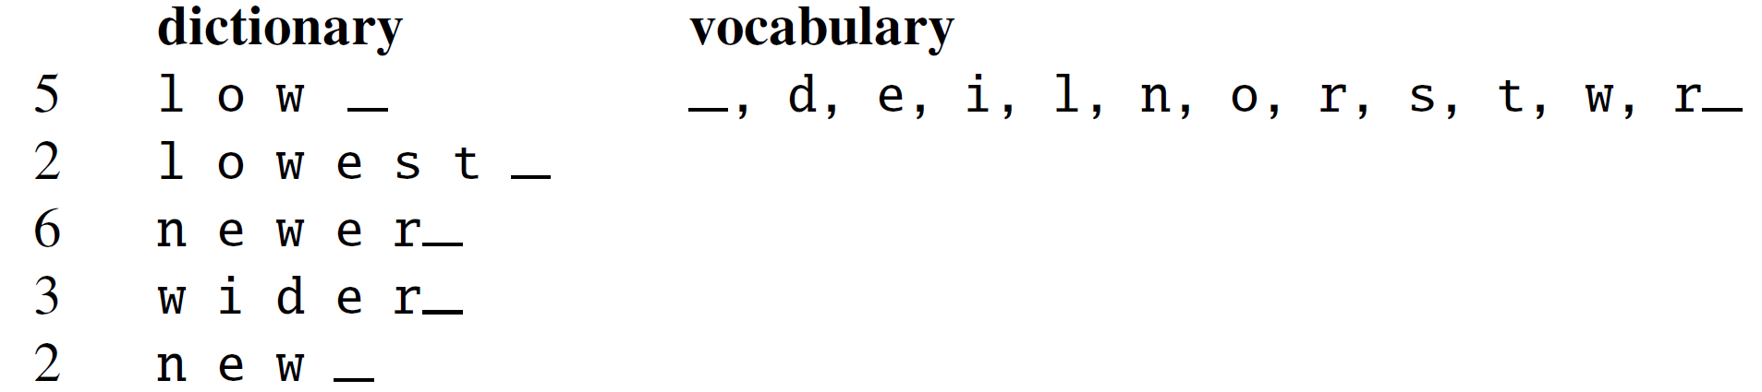
BPE, example
r _ is merged to r_

Slide 56
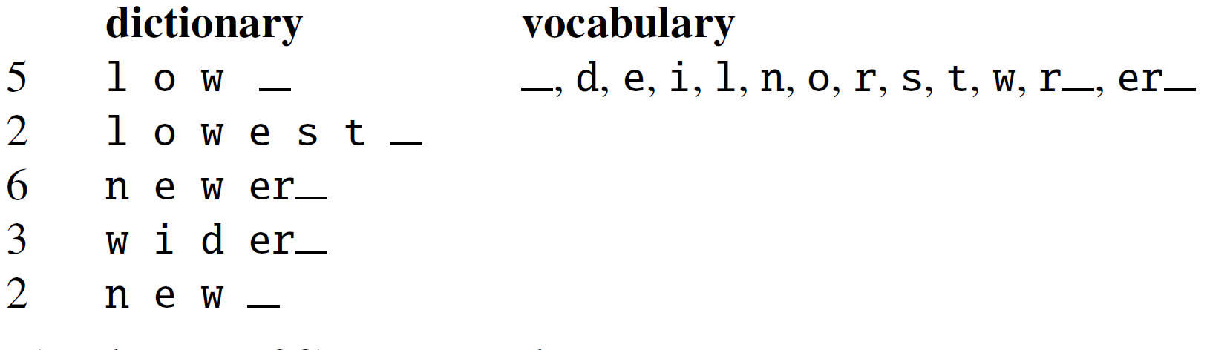
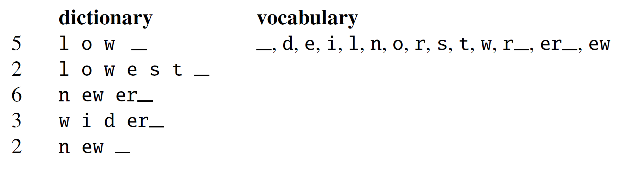
e r_ is merged to er_
e w is merged to ew

Slide 57
